Slide 1
Generative AI:
Friend or Foe - Convincing Faculty It’s Worth the Risk
Jeanette Jones, MSN-Ed, RN
Dean of Instruction
Jean Vanderzee, BA
Dean of Faculty
Jordan Utley, Phd, ATC, FNAP
Director of Education
Notes:
Jean
Ask who has played around with it?
Today we'll explore generative AI, its history, and how it's reshaping various fields, including education and healthcare. We'll also look at different versions and practical applications for both instructors and students.

Slide 2
"I was never comfortable about using it. I didn't even want my students using it. I thought it was just a "cheating" tool for them. After the training I had a better and clear understanding of it. I have talked about it with my students, and have used it a few times already for assistance with in class projects and scenarios."
Notes:
Jean

Slide 3
SESSION AGENDA
Definition, Timeline & Supporting Research
Getting Started with ChatGPT
Student Support: Math
Student Support: Chat GPT Tutor
Faculty Use: Case Scenarios
Notes:
Jean
jean will insert mentimeter

Slide 4
DEFINITION: Generative Artificial Intelligence (GAI)
“Generative artificial intelligence (AI) describes algorithms (such as ChatGPT) that can be used to create new content, including audio, code, images, text, simulations, and videos.”
https://www.mckinsey.com/featured-insights/mckinsey-explainers/what-is-generative-ai#/
Notes:
Jordan does intro and research:
Generative AI refers to artificial intelligence systems capable of creating new content. This can include text, images, audio, video, and even computer code. The key feature that sets generative AI apart is its ability to produce original outputs based on the patterns it has learned from training data. It can also do this very quickly.
AI is here! Faculty have access to it…students have access to it, so let’s figure out how to use it for good.

Slide 5
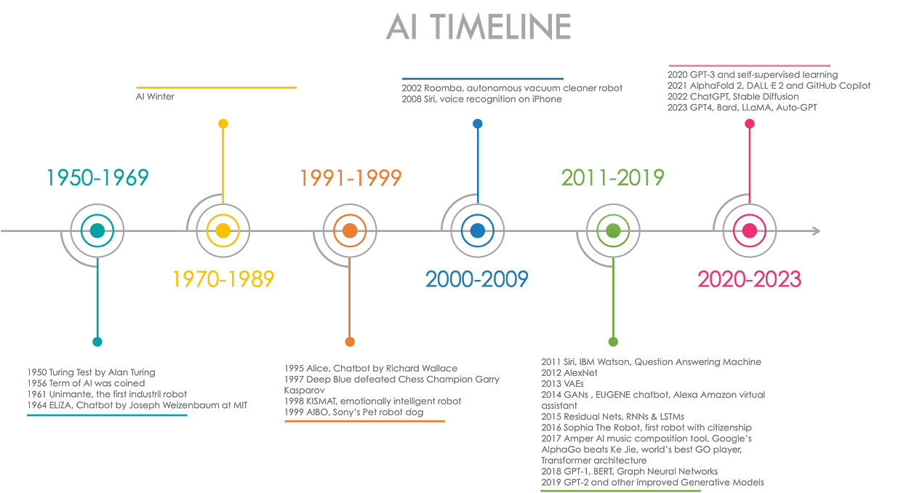
Generative AI Timeline
Notes:
Jordan
The roots of generative AI can be traced back to the 1950s with early concepts of machine learning- 1st design was used to play checkers. In the 60s Eliza was considered the 1st chatbot which was a talking computer program that would respond to a human, using a natural language and responses designed to sound empathic (Turing Test). In the 1980s Deep learning was developed that uses algorithms to process the data and to imitate the human thinking process.
In this century, you can see there has been rapid advancements with models like GPT-3; GPT stands for generative pre-trained transformer, and DALL-E. AI models like GPT-3 can write essays, while DALL-E can create images from text descriptions. Many different versions of Ai out there.
Think Alexa and Siri these are voice assistants powered by AI. Google uses AI… it is all around us.
The Turing test is a method for evaluating a machine's ability to exhibit human-like intelligence. The test is named after Alan Turing, an English computer scientist, mathematician, and cryptanalyst who proposed it in his 1950 essay, "Computing machinery and intelligence". The test involves a human interrogator attempting to determine if a participant in a natural-language conversation is a human or a computer. The participant passes the test if the interrogator is convinced that the participant is human.

Slide 6
Why do we need to learn about AI?
Notes:
Jordan
AI is now impacting healthcare

Slide 7
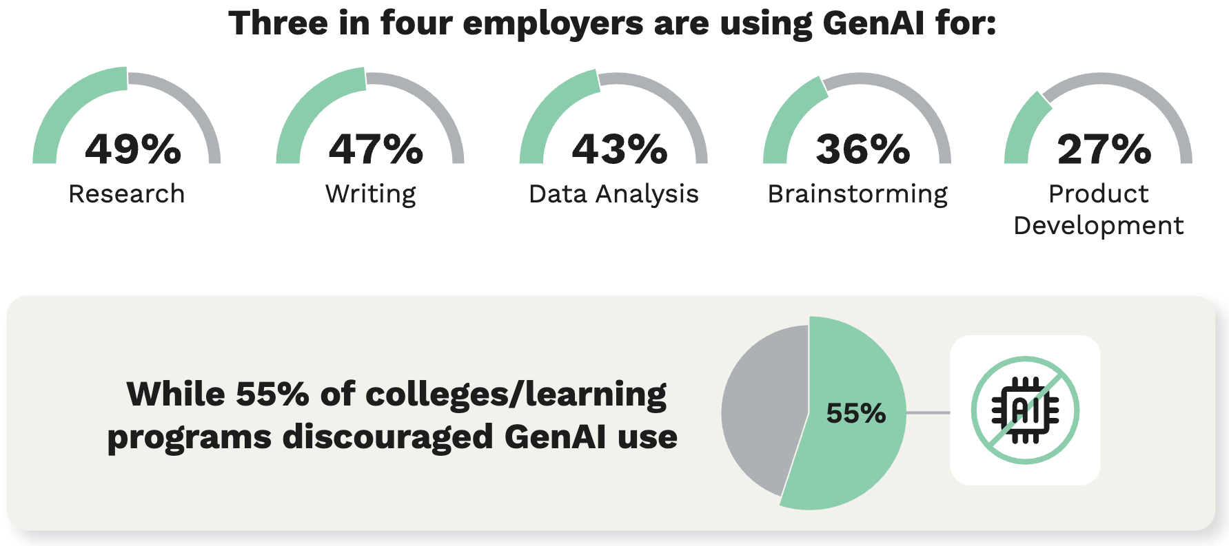
Employer/Student Skill Mismatch
Cengage Employability Report (2024)
Surveyed Employers (N=1000) + 2-year and 4-year graduates (N=974)
https://cengage.widen.net/s/bmjxxjx9mm/cg-2024-employability-survey-report
Notes:
The 2024 Graduate Employability Report findings are based on two online surveys conducted among 1000 U.S. employers and 974 recent graduates/students from May 2, 2024, to May 28, 2024, via Pollfish. The employer survey collected responses from 1,000 working adults employed for wages across all fields, with demographic quotas set for gender and age ranges. The graduate/worker survey gathered 974 responses from individuals who received a 2- or 4- year degree and/or a skills certification within the last year.

Slide 8
Employer/Student Skill Mismatch
Employer/Student Skill Mismatch
Cengage Employability Report (2024)
62%
of employers believe candidates and employees should have foundational knowledge of GenAI tools
58%
being more likely to interview and hire those with AI experience
64%
note that many employees will need to reskill or upskill in the next three to five years due to emerging technologies
https://cengage.widen.net/s/bmjxxjx9mm/cg-2024-employability-survey-report
Notes:
JORDAN Add slide data from Webinar

Slide 9
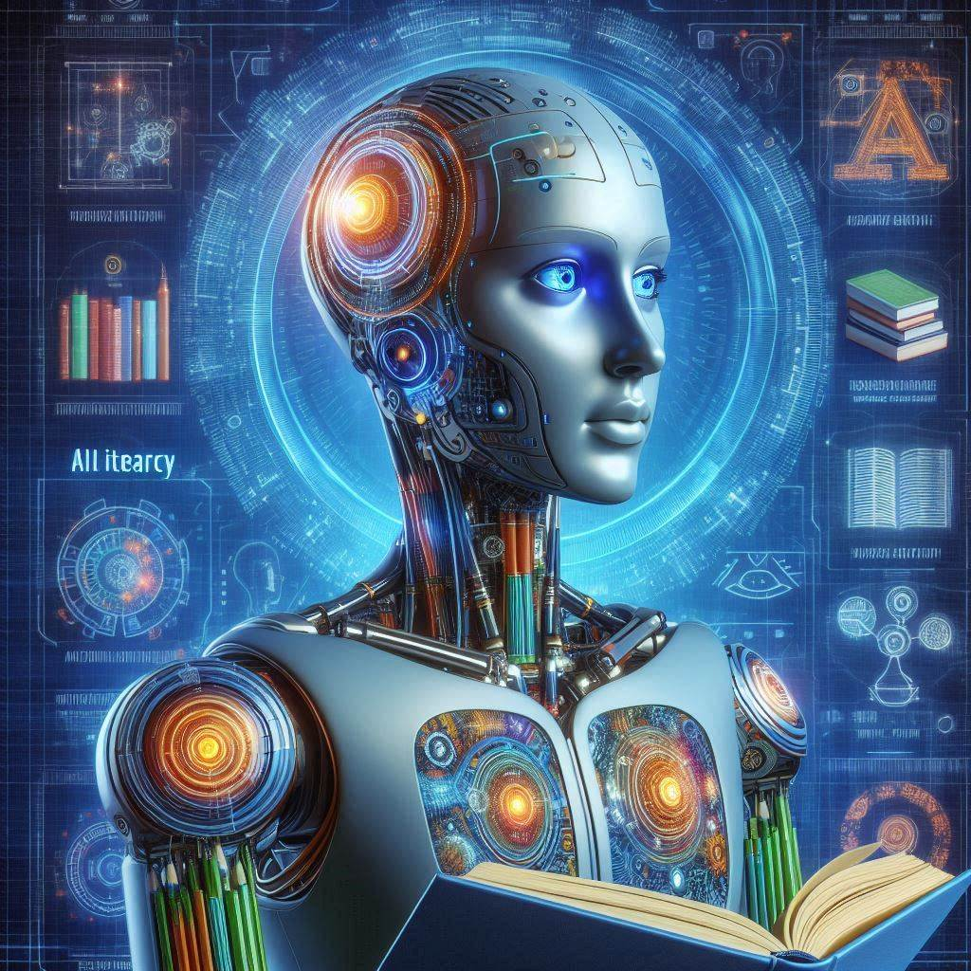
OBJECTIVE: IMPROVE FACULTY LITERACY→ STUDENT LITERACY
“AI literacy is the knowledge and skills that enable humans to understand, use, and
evaluate AI systems and tools to
safely and ethically
participate in an increasingly digital world.”
Mills, K , Ruiz, P , Lee, K , Coenraad, M , Fusco, J , Roschelle, J & Weisgrau, J. (2024). AI Literacy: A Framework to Understand, Evaluate, and Use Emerging Technology. Retrieved from https://doi org/10 51388/20 500 12265/218
Notes:
Jordan does intro and research:
*image by bing AI creator
Generative AI refers to artificial intelligence systems capable of creating new content. This can include text, images, audio, video, and even computer code. The key feature that sets generative AI apart is its ability to produce original outputs based on the patterns it has learned from training data. It can also do this very quickly.
AI is here! Faculty have access to it…students have access to it, so let’s figure out how to use it for good.

Slide 10
AI Chatbots Outshine Human Doctors in Empathy:
The Future of Patient Communication
This cross-sectional study of 195 randomly drawn patient questions (from a social media forum) answered by physicians and chatbots and reviewed by a panel of healthcare professionals found that:
Healthcare professionals preferred ChatGPT's responses to physician responses roughly 79% of the time
ChatGPT's responses were longer and rated higher in both quality and empathy compared to the physician responses
Ayers JW, Poliak A, Dredze M, Leas EC, Zhu Z, Kelley JB, Faix DJ, Goodman AM, Longhurst CA, Hogarth M, Smith DM. Comparing Physician and Artificial Intelligence Chatbot Responses to Patient Questions Posted to a Public Social Media Forum. JAMA Intern Med. 2023 Jun 1;183(6):589-596. doi: 10.1001/jamainternmed.2023.1838. PMID: 37115527; PMCID: PMC10148230.
Notes:
jordan

Slide 11
Effectiveness of artificial intelligence-assisted colonoscopy (AI-C) in early diagnosis of
colorectal cancer: a systematic review
This systematic review investigates the effectiveness of AI-C in the early diagnosis of CRC as compared to conventional colonoscopy.
AI-C improves adenoma and polyp detection, especially those usually missed by conventional colonoscopy, thereby reducing adenoma miss rate and polyp reduction rate by 50%.
Mehta, Aashna MDa; Kumar, Harendra MBBSb; Yazji, Katia MB, BCh, BAOc; Wireko, Andrew A. MBBSd; Sivanandan Nagarajan, Jai MBBSh; Ghosh, Bikona MBBSf; Nahas, Ahmad MBBSa; Morales Ojeda, Luis MDg; Anand, Ayush MBBSe; Sharath, Medha MBBSi; Huang, Helen MB, BCh, BAOc; Garg, Tulika MBBSj; Isik, Arda MD, FACSk. Effectiveness of artificial intelligence-assisted colonoscopy in early diagnosis of colorectal cancer: a systematic review. International Journal of Surgery 109(4):p 946-952, April 2023. | DOI: 10.1097/JS9.0000000000000285
Notes:
jordan

Slide 12
Why should Faculty learn about AI?
Benefits:
Idea generation, starting point
Content creation
Efficient problem-solving
Sample/example generation
Makes complex tasks more accessible to non-experts
24/7 availability
Used in the healthcare workplace
Limitations:
Accuracy
There must always be a “human in the loop”
May perpetuate biases in training data – and results
Poses issues of copyright, misinformation, and privacy
Notes:
Jeanette:
add the ethical dilemma example for faculty who use it for own use but not for students.
There are benefits and challenges or limitations with GAI:
Benefits:
Generates ideas and content
Speeds up content creation and problem-solving
Enables tailored experiences and outputs
Makes complex tasks more accessible to non-experts
24/7 availability
Limitations:
Operates on patterns, not genuine comprehension
Can perpetuate biases in training data
Often requires significant computing power
May struggle with extended outputs
Raises issues of copyright, misinformation, and privacy
We are seeing the publishers wrestling with this. They are choosing to create “grounded AI” which can only gather information from the source text. They do not want to enter their textbook information into AI, since then the content becomes part of the information that is accessible to AI when responding or answering new questions.
*Use last bullet in benefits for a transition into 14

Slide 13
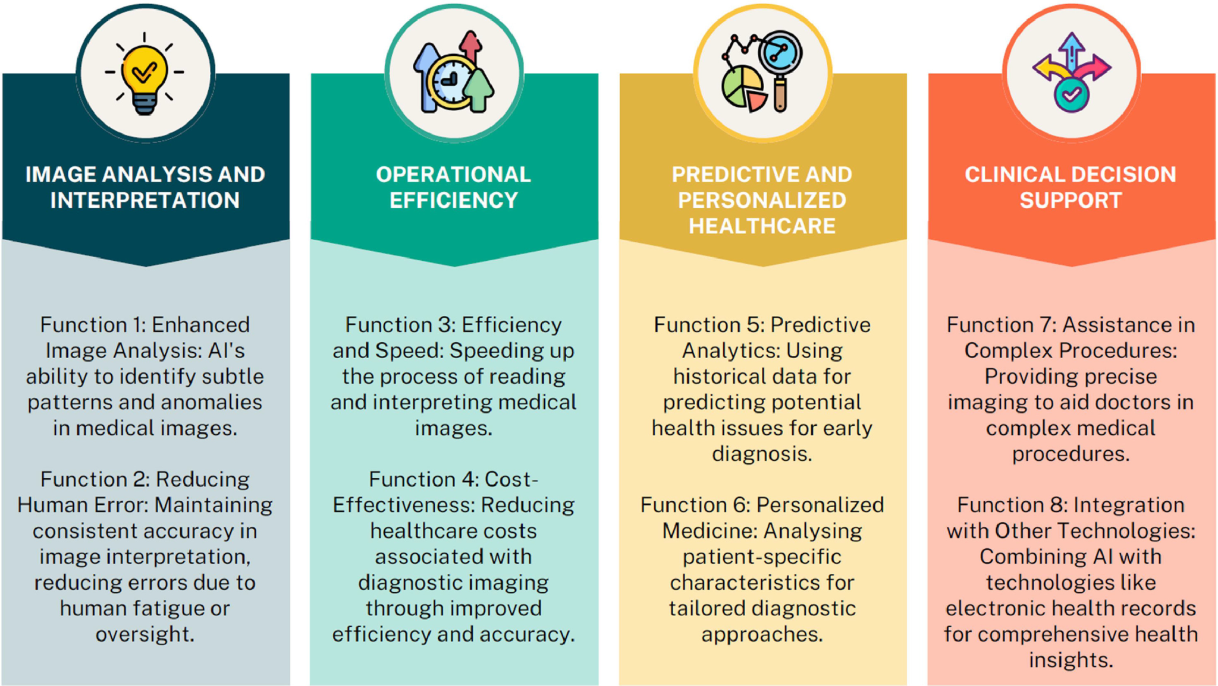
Four Domains and Eight Functions of AI Use in Diagnostic Imaging
Khalifa, M., & Albadawy, M. (2024). AI in diagnostic imaging: Revolutionising accuracy and efficiency. Computer Methods and Programs in Biomedicine Update, 100146.
Notes:
Jeanette
Data from a 2024 scoping review; this table summarizes the 4 domains and 8 functions of AI in imaging.
bridges into healthcare and use it as an exemplar

Slide 14
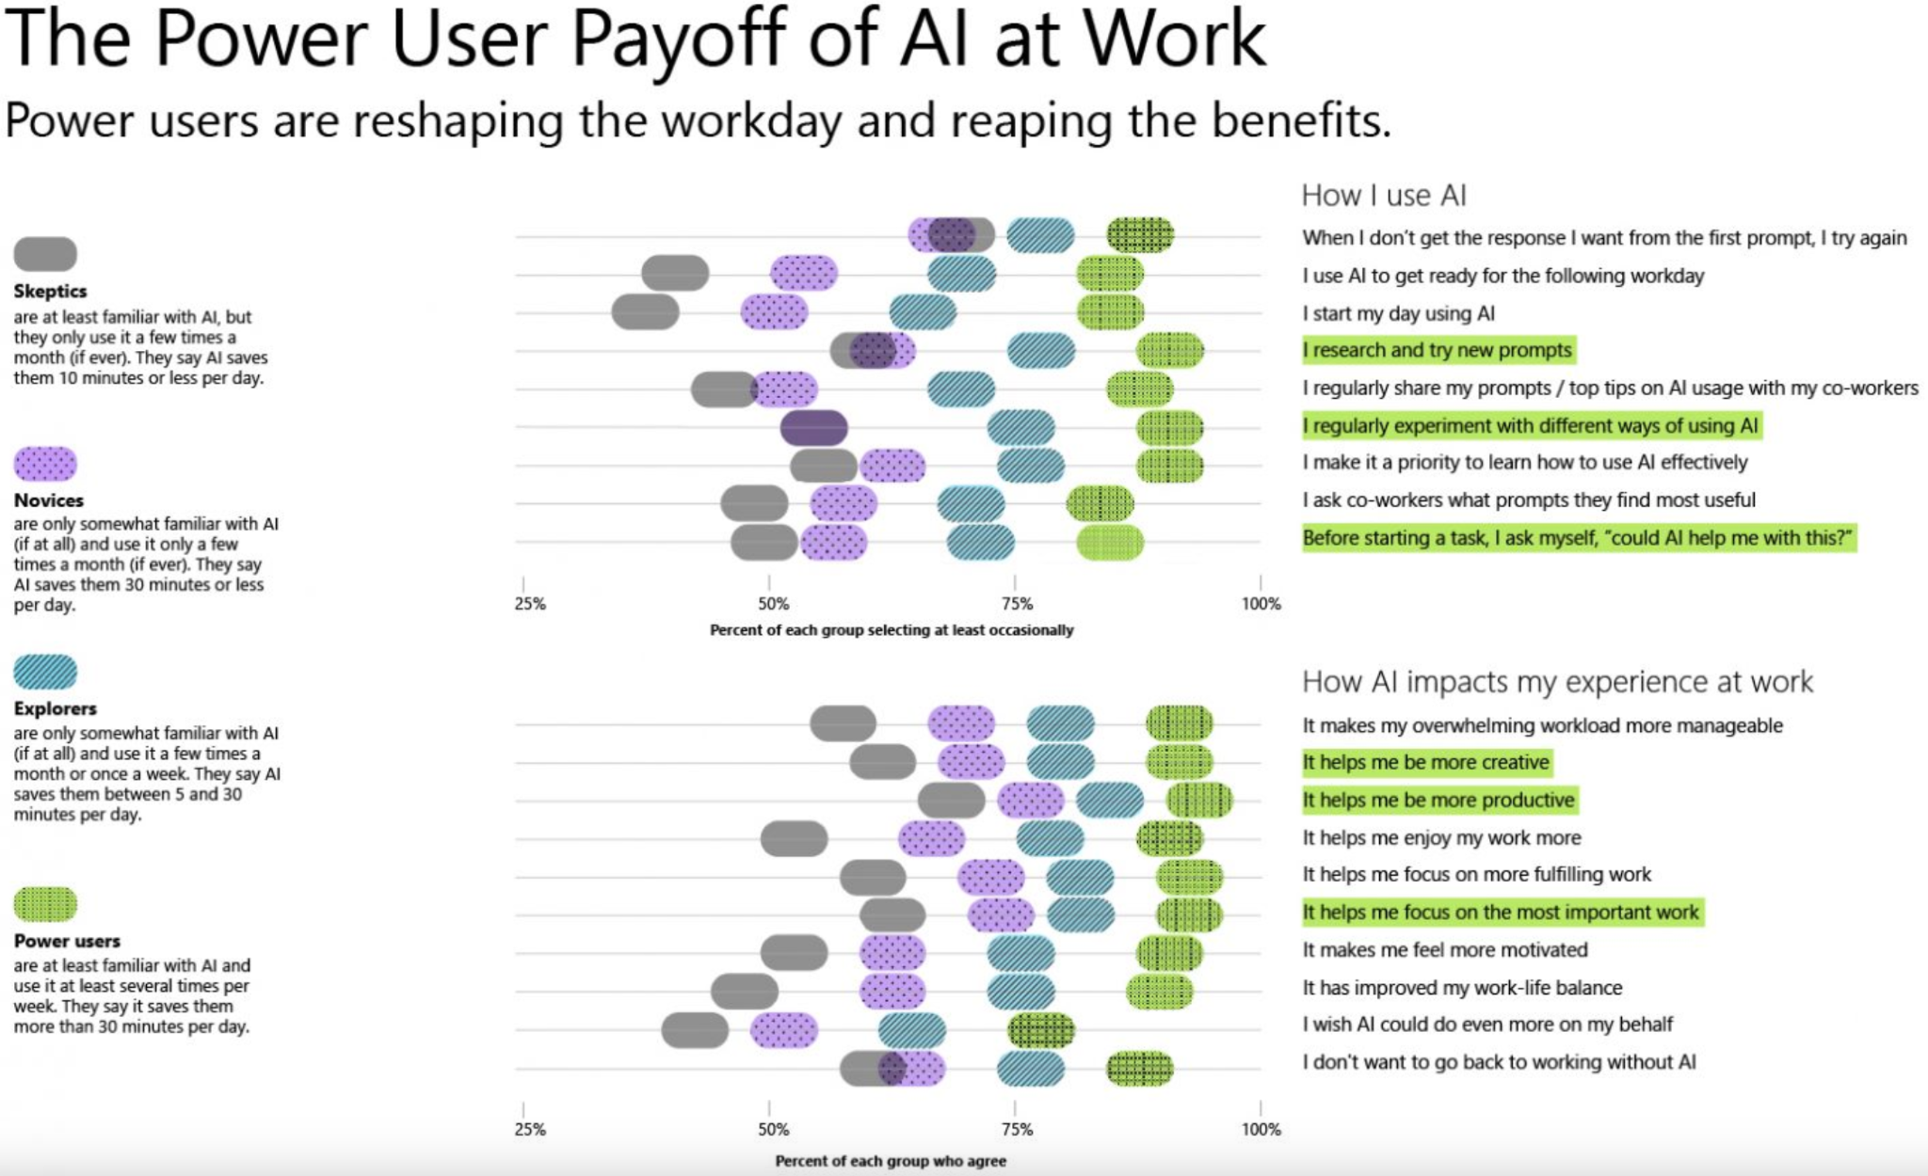
Microsoft & LinkedIn Work Trends Report (2024): https://www.microsoft.com/en-us/worklab/work-trend-index/ai-at-work-is-here-now-comes-the-hard-part
Notes:
Jeanette
Ethically, I’m still doing the work–it is improving my efficiency
Critical thinking–human still must be in the loop
Faculty are using it—why are we holding our students back? how do we help our faculty get into the blue
Adult learners–time is limited
this is not taking the place of a person works it changes how we work; co-intelligence
people who use AI will be replaced with people who don’t

Slide 15
Ethical Dilemmas and Challenges
Risk of bias
Perpetuate disparities in healthcare outcomes, exacerbating inequities among patient populations
Protection of patient data privacy
Highly personal nature of medical information
Implementing stringent data security measures is critical to maintaining patient trust and adhering to legal standards
Successful integration of AI technologies into existing healthcare
Demands a collaborative approach
Mesh the innovative capabilities of AI with the expertise of medical professionals
Khalifa, M., & Albadawy, M. (2024). AI in diagnostic imaging: Revolutionising accuracy and efficiency. Computer Methods and Programs in Biomedicine Update, 100146.
Notes:
jeanette

Slide 16
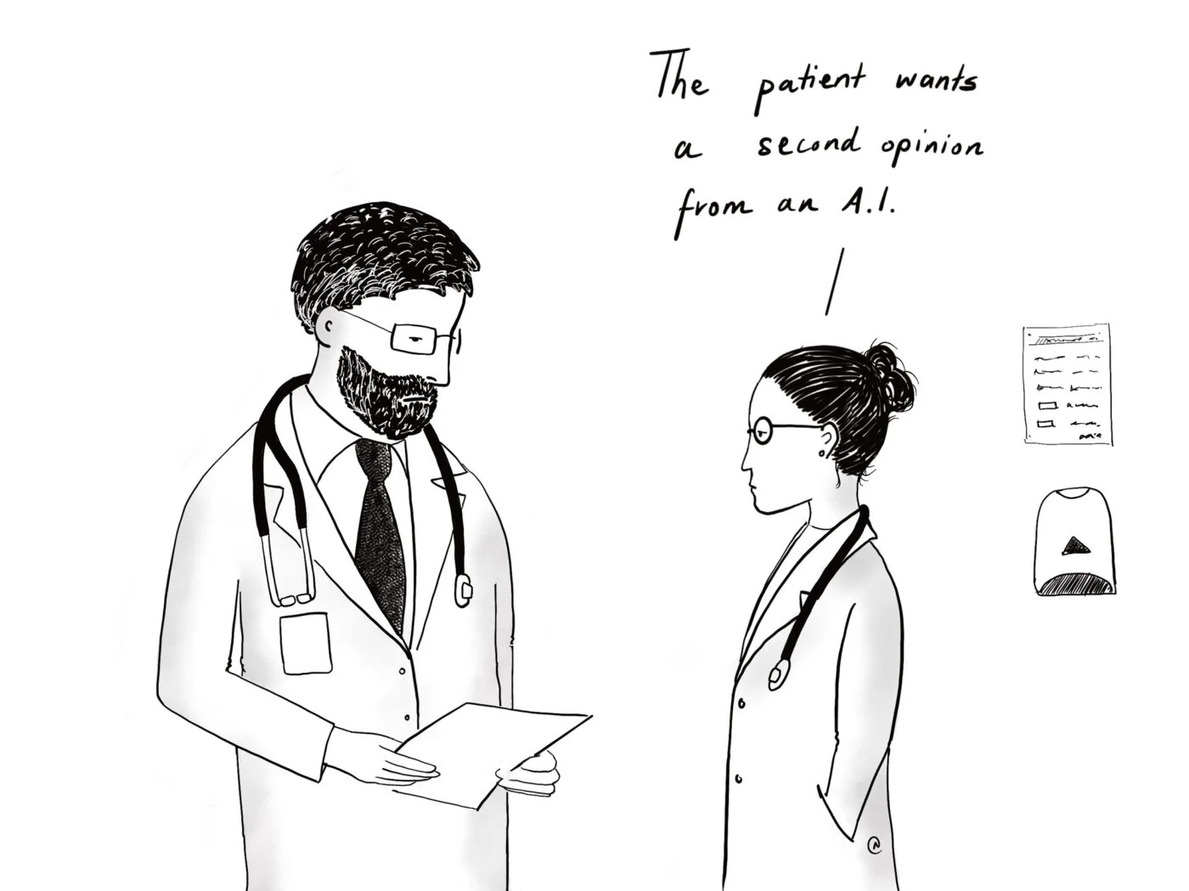
PATIENT HEADS UP
40%
Projected improvement in health outcomes when using AI for diagnoses
Harvard School for Public Health
Notes:
Jeanette
connect to head in the sand analogy
this is the next level of Web MD and google.
8.5 months to 15 years
Educators
Healthcare Professionals
Accountants
Role of the division is:
Contemporary curriculum
Purchasing classroom supplies

Slide 17
What’s out there and where should we start?
Top GAI Tools
Notes:
Jean

Slide 18
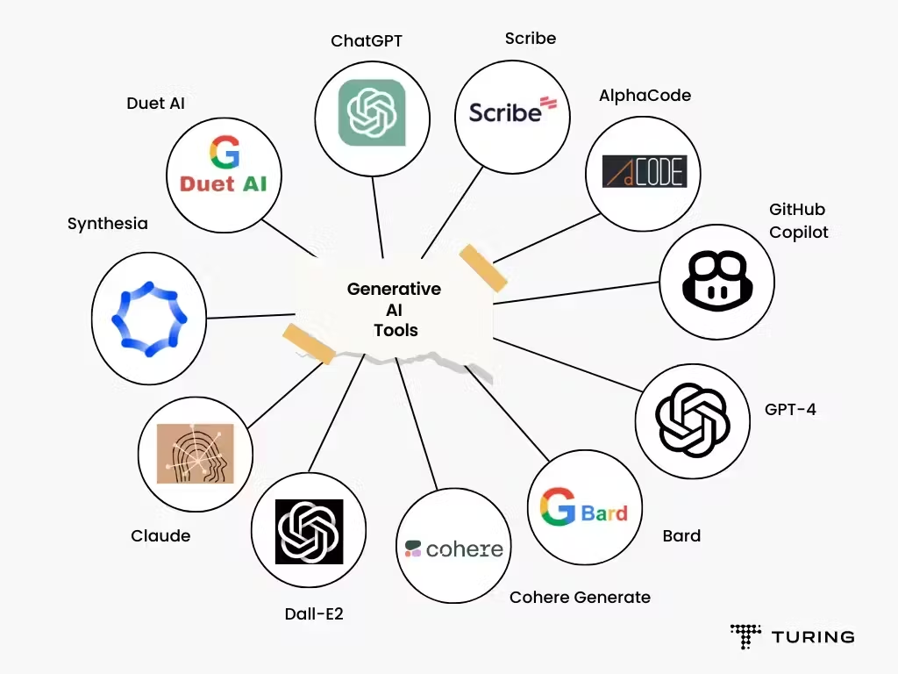
Notes:
Jean
These do require incredible energy to do their work. Elon Musk’s new Xai has the following stats:
Musk claims the supercluster is powered by 100,000 state-of-the-art Nvidia H100 chips
Former Stability AI CEO Emad Mostaque speculated that at 2.5 exaflops (meaning it can calculate 2.5 quintillion floating-point operations per second), it’s said to be more than twice as fast as the current record-holder — the US Department of Energy’s Frontier computer
Mostaque believes the computer would be able to train the likes of GPT-4 in just a week
The 785,000-square-foot facility is considered one of the largest-ever investments in the Memphis area
During peak training periods, the gigafactory could need as much as 150 megawatts of electricity — the same amount needed to power 100,000 homes.

Slide 19
01
GETTING STARTED
ChatGPT
Step-by-step guide
Set up an Account
Notes:
Jean

Slide 20
How can I access ChatGPT?
On campus
Anywhere (On your smartphone)
Disconnect from campus network
Connect to Wifi
In your web browser, go to http://openai.com
Go to your app store
Download:
Notes:
jean
walk thru this

Slide 21
Setting up your account
Click on “Sign Up” and enter your email
Verify your email and complete the registration process
Login to new account on the app or at http://openai.com
Notes:
Jean

Slide 22
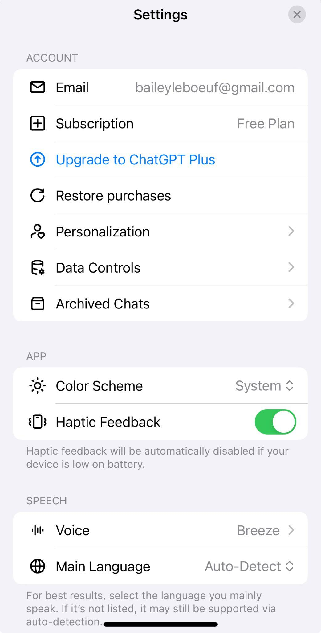
Custom Instructions!
Click on your name icon (bottom left)
Click “Personalization”
Click “Custom Instructions”
Answer questions to apply to all of your ChatGPT conversations.
Notes:
Jean
ChatGPT will learn about your preferences as you interact with it. You can expedite this process by setting up custom instructions.
This step is totally optional, but will impact the kind of responses you get.

Slide 23
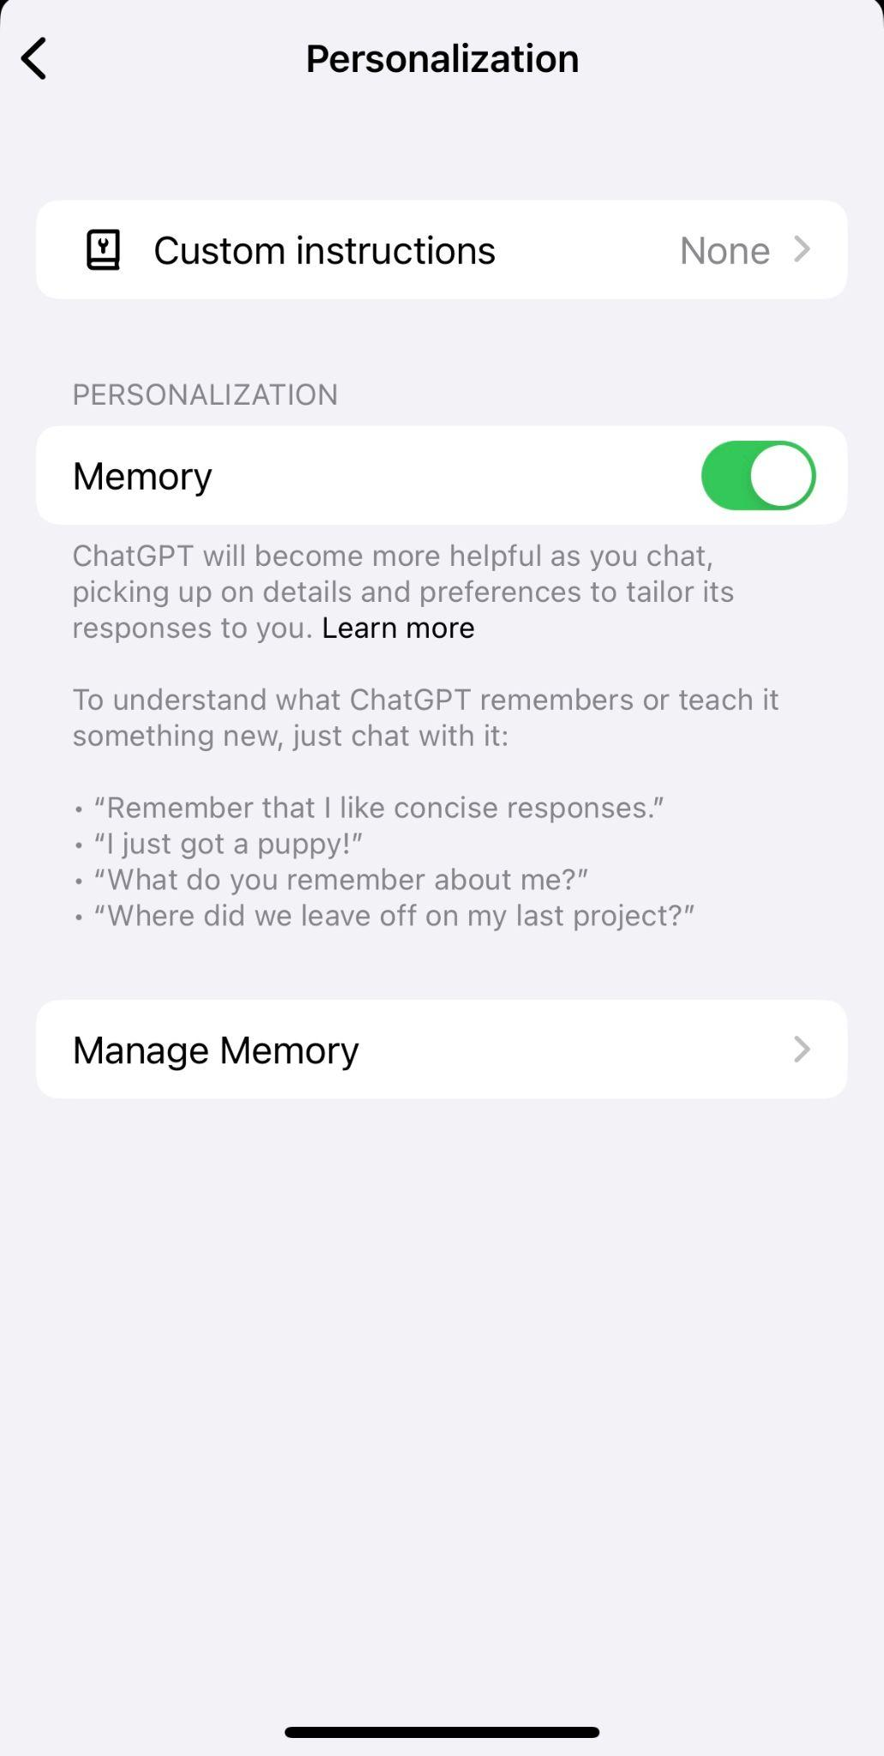
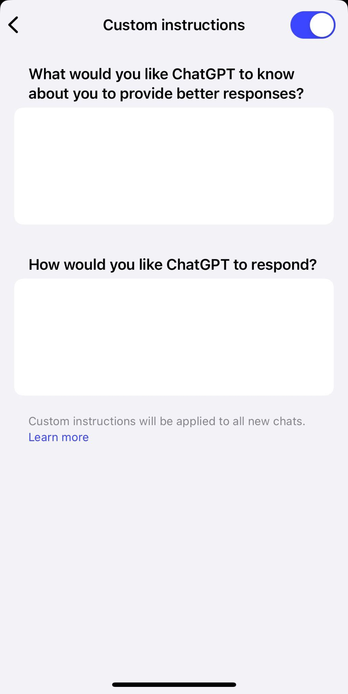
Custom Instructions!
Notes:
Jean
Memory is selected so Chat GPT can learn from your requests and refinements.
You can add any other preferences you want in the questions boxes.
“I am an instructor in a Pharmacy Technician Certificate Program”
“Respond in a formal, academic writing style”
“I prefer detailed responses”
“Use medical terminology”

Slide 24
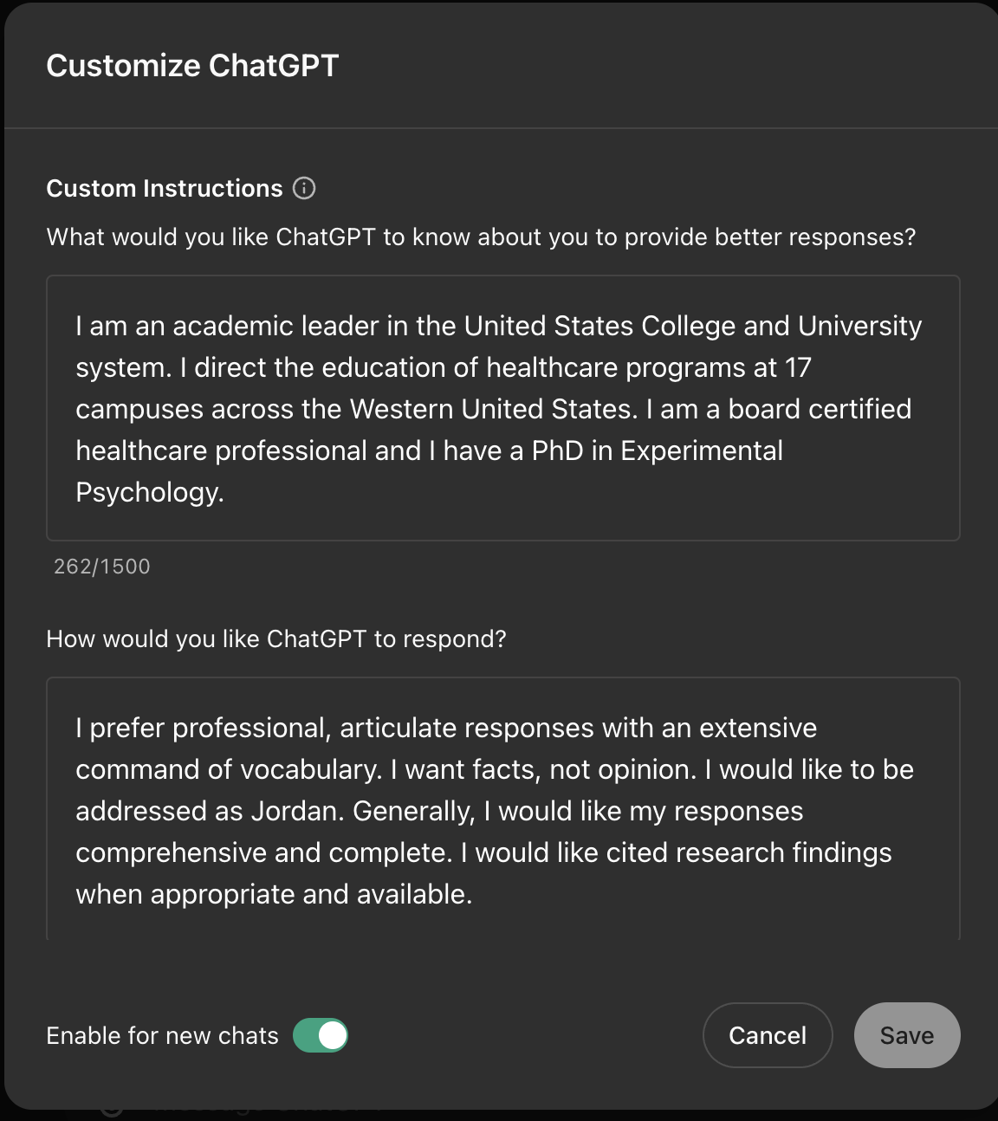
Customize your Responses (Laptop)
Notes:
Jean
Here is an example of the profile that Dr. Jordan Utley set up

Slide 25
“HIGHER EDUCATION BEACH”
PMI Faculty
50%
Projected reduction in treatment costs when using AI for diagnoses
Harvard School for Public Health
HEADS UP!
Notes:
Jean
Jean’s comment: on Faculty use (MS degree) & not letting students use it

Slide 26
Now that you’re running around with ChatGPT….What guidance does (PMI) provide?
PMI-027 Student Code of Conduct
Effective 11-01-23
“iii. Citable work used for the purposes of completing assignments, quizzes, and exams, including, but not limited to, books, journal articles, blogs, images, lectures, internet postings, and content generated by software or artificial intelligence.”
“iii. Taking credit for any work not created by the student.”
Notes:
Jeanette
changed our student conduct policy
added this into syllabi January 2024

Slide 27
What guidance does your syllabus provide for the Student?
Use prohibited
Students are not allowed to use advanced automated tools (artificial intelligence or machine learning tools such as ChatGPT) on assignments in this course. Each student is expected to complete each assignment without substantive assistance from others, including automated tools.
-or-
Use only with prior permission & acknowledgment
Students are allowed to use artificial intelligence tools (such as ChatGPT) on assignments in this course if faculty permission is obtained in advance, and if that use is properly documented and credited.
PMI Faculty surveyed May 2024: 40%
Notes:
Jeanette
All certificate syllabi contain the green language. Why do you think that when given a choice, frequently other faculty chose the language in red?

Slide 28
Use with Permission: Citation
Text generated using ChatGPT should include a citation
Chat-GPT-4o. (YYYY, Month DD of query). “Text of your query.” Generated using OpenAI. https://chat.openai.com/
Notes:
Jeanette

Slide 29
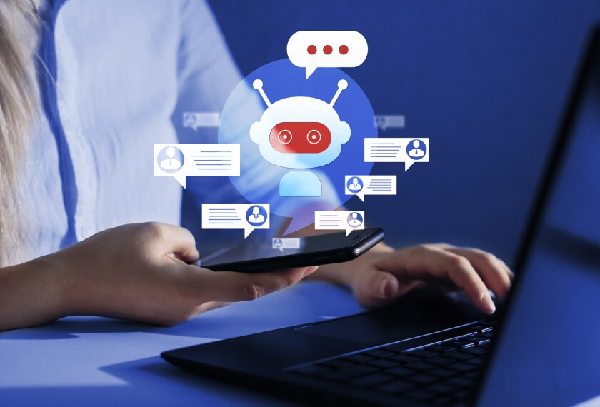
STUDENT AI USE
Notes:
Jeanette
The most common response from faculty is a fear of having students using AI - especially since they believe the primary way it will be used is for cheating.

Slide 30
02
STUDENT USE
Math Help
Students can ask Chat GPT to solve problems and provide detailed instructions on solving them.
GPT-4O Launch
Notes:
Jeanette
Let’s look at an example.
Video of GPT-4o (14 min - math/21:50 language translation)
It is a very patient tutor.
math is one of the most highly failed courses. - students are anxious about asking for help with this subject

Slide 31
“By leveraging AI, educators can create adaptive learning environments that cater to individual student needs, enhancing engagement and retention.”
(Onesi-Ozigagun et al., 2024)
Notes:
Jeanette
fills in the gaps and helps enhance learning

Slide 32
03
STUDENT USE
ChatGPT Tutor
Students can create prompts to produce multiple choice practice questions with feedback. Let’s walk through an example prompt.
Notes:
Jeanette- cue video for example of upload books and practice
Ask it to make MC for A&P content for CAT 150
Exam prep
Where are students copying & pasting from? PDF of textbook? eBook?

Slide 33
Practice & Reflection
Notes:
Jeanette The value of this workshop was “using the tools”
Take 20-30 mins to practice with whatever resource you want to create- you can use the prompts in the FRC to help guide you.
Jeanette
We can all share experience
Peer-guided is some of the most rich examples of this
MA Faculty who collaborated with ChatGPT to build a website that allows her students to practice verifying insurance
PTA Faculty who used case studies to assign identities to the chat bot to allow practice interviewing patients to take medical histories
Nursing Faculty using AI to build NGN style quiz questions by uploading one example as a prompt
How can faculty prep for practice and reflection in the classroom - model the use of effective or non-effective prompts; model how to critically evaluate responses. Lay groundwork for how prompts can be gradeable events

Slide 34
CRITIQUE
“While the tool may be able to provide quick and easy answers to questions, it does not build critical thinking and problem-solving skills, which are essentials for academic and lifelong success.”
(Korn & Kelly, 2023, para. 3)
Notes:
Jordan: Human in the loop theme

Slide 35
SO…
“...construct your assignments to align with learning
goals and the availability of these systems.”
(Schiappa & Montfort, 2023, pg 1)
Notes:
Jordan

Slide 36
OBJECTIVE: Analyze ways to create authentic and meaningful assessments with the existence of artificial intelligence (AI).
Assignment Type | How to “ChatGPT-ize”
Discussion Question | Ask students to: Include their personal experience or perspectives in their answers Create a video response for a discussion or use other digital forms of learning artifacts such as animations Reference specific pages (pp. 145-152) of the textbook (or learning materials) to summarize the “x” and include their own experiences and opinions to support their answer Summarize photos or mind maps/visuals of a process or action plan
Notes:
Could the prompt be gradable? Might the assessment of Critical Thinking be what we are interested in?
AI for Education Webinar Series

Slide 37
Assignment Type | How to “ChatGPT-ize”
Paper/Essay | Ask students to: Conduct an analysis that draws on specific class discussions Write about the most recent events that are not necessarily reflected in the data used to train the language model Critique a piece of writing generated by ChatGPT by analyzing and interpreting how it conveys an idea and assessing its strengths and weaknesses in terms of credibility and accuracy by referencing textbooks and scholarly readings Reflect on the process of finding the answer, and less on the answer
Notes:
Jordan
COS MLT example
We are trying to change their mindset from “catching students” to effective use of the tool
Turin it in (4% false positive)
Massachusetts example of lawsuit
AI “skills” that employers are seeking–our job is education—aligning skills we teach with the workforce need

Slide 38
FACULTY AI USE: What will you do?
Notes:
jean

Slide 39
FACULTY AI USE: EFFICIENCY
THINK ABOUT YOUR NEXT START…
WHAT DO YOU NEED TO CREATE?
• Course schedule
• Creating Case Scenarios
• Interactive learning activities
(e.g. worksheets, patient scenarios/case studies)
• Grading rubrics
• Discussion prompts and questions
• Summarize complex topics for lecture prep
• Assessments and exams
• Set of personalized feedback
Notes:
jean

Slide 40
04
FACULTY USE
Case Scenarios
You can create prompts to produce case scenarios... let’s walk through an example prompt.
Notes:
jean
We are going to walk through through a couple samples of how to use GAI as instructors.

Slide 41
Creating Simulated Patient Scenarios
Access your prompt sheet from your email
Copy and paste the top prompt into the ChatGPT text bar
Refine your prompt if it isn’t exactly what you want
Notes:
Jean
So I know that case studies are an effective teaching tool but they are time-consuming to come up with. I’m going to outsource that. It doesn’t have to be complicated.
Input number 2

Slide 42
Creating Simulated Patient Scenarios
Now, engage like a student in a role-play, possibly taking a medical history based on AI’s responses.
Example Questions: "How long have you been experiencing symptoms?" "Can you describe your symptoms in more detail?"
Student Assignment: Analyze/reflect on the interaction and discuss the effectiveness of interviewing/history-taking techniques.
AI
Notes:
Jean
what else should I ask
I’m not an MA what should I ask next?
type in based off of scenario 2

Slide 43
Case Study Prompts
A list of ready to go case study prompts were in the email you received
Select the file called Case Study Prompts
Practice adjusting these cases by adding comorbidities, or other issues that students need to be able to identify or address
Notes:
Jean
Maybe you teach mental health and want to add in an element of interpersonal skill development and deescalation. I’m going to make my patient also be angry.
Chat GPT is conversational, it does not need to be complicated, you can ask it to do things as though you are asking an assistant, only you don’t need to think about manners. In fact, I often have to fight the urge to type back “thank you” after it does something perfectly for me. Not necessary.
You can also ask Chat GPT to give you feedback on your responses and how effective you were at deescalating the patient, tips for improvement.
However, if you would like a more ready made, less personalized prompt, we are also going to share some with you that don't require as much refining. I’ll walk you through one of these examples.

Slide 44
“AI has a positive impact on the learning experience by facilitating the acquisition of new knowledge and skills.”
(Slimi, 2023)
An effective prompt is a durable skill…
Notes:
Jean

Slide 45
Other Inservice Examples
• Course schedules
• Lesson plans
• Interactive learning activities
(e.g. worksheets, patient scenarios/case studies)
• Grading rubrics
• Discussion prompts and questions
• Assessments and exams
• Personalized feedback
Notes:
Jean - critical thinking - prompt engineering - refining assessment (AI for Education podcast–the chat with the bot can be graded)
So we have looked at interactive activities, what else would you like to see from this list, or other ideas not on the list…
Critical Thinking

Slide 46
“In the U.S. alone, 37 percent of the top 20 skills considered necessary for the average job
have changed since 2016.
One in five skills is entirely new.”
(Selingo, 2024)
https://www.ecampusnews.com/files/2023/01/the-new-learning-economy-whitepaper-2403041.pdf
Notes:
Jean

Slide 47
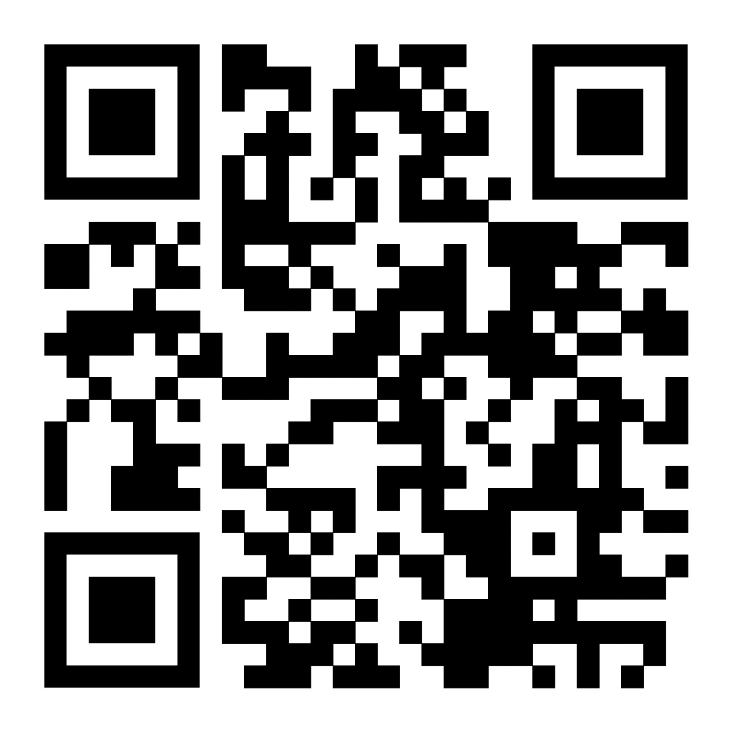
Jordan Utley, PhD, ATC, FNAP
Director of Education
Pima Medical Institute
THANK YOU
________
QUESTIONS
Jeanette Jones, MSN-Ed, RN
Dean of Instruction
Pima Medical Institute
SCAN for RESOURCES
Jean Vanderzee, BA
Dean of Faculty
Pima Medical Institute
Notes:
Jean pulls over author slide from CBEN

Slide 48
FINAL THOUGHTS
How can faculty ensure students are prepared to encounter AI in the field?
How will you/your faculty utilize it in the classroom?
Where will you start?
Notes:
Have students use AI to create specific clinical tasks or items (ex: have them use ChatGPT to create a physician’s schedule or a treatment plan)
Talk to your advisory boards about how they are seeing AI develop in their practice, and how we might better prepare students to use this technology.
Have students do research projects on how AI is being used in their specific field.

